Slide 1
Chat App

Slide 2
Outline
Introduce team
Use cases
UML and Design Patterns
GUI Demo
Q/A

Slide 3
Outline
Introduce team
Use cases
UML and Design Patterns
GUI Demo
Q/A

Slide 4
Outline
Introduce team
Use cases
UML and Design Patterns
GUI Demo
Q/A

Slide 5
Use Cases
Create User -> sign up with username, password, age, school and interests
Create Room -> public or private with specified capacity
Join/leave room
Room Admin
Invite user
Ban user
Messages
private / public message
“hate” words

Slide 6
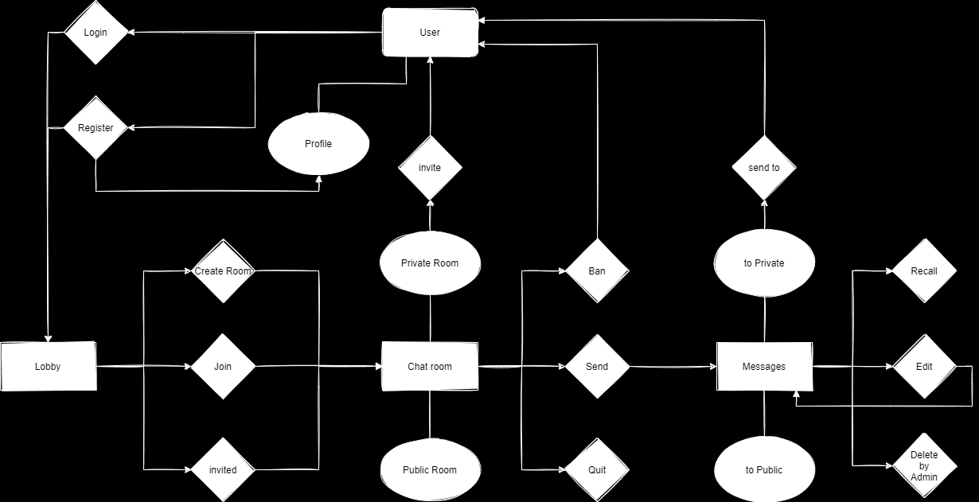
User
Lobby
Room
Message

Slide 7
Outline
Introduce team
Use cases
UML and Design Patterns
GUI Demo
Q/A

Slide 8
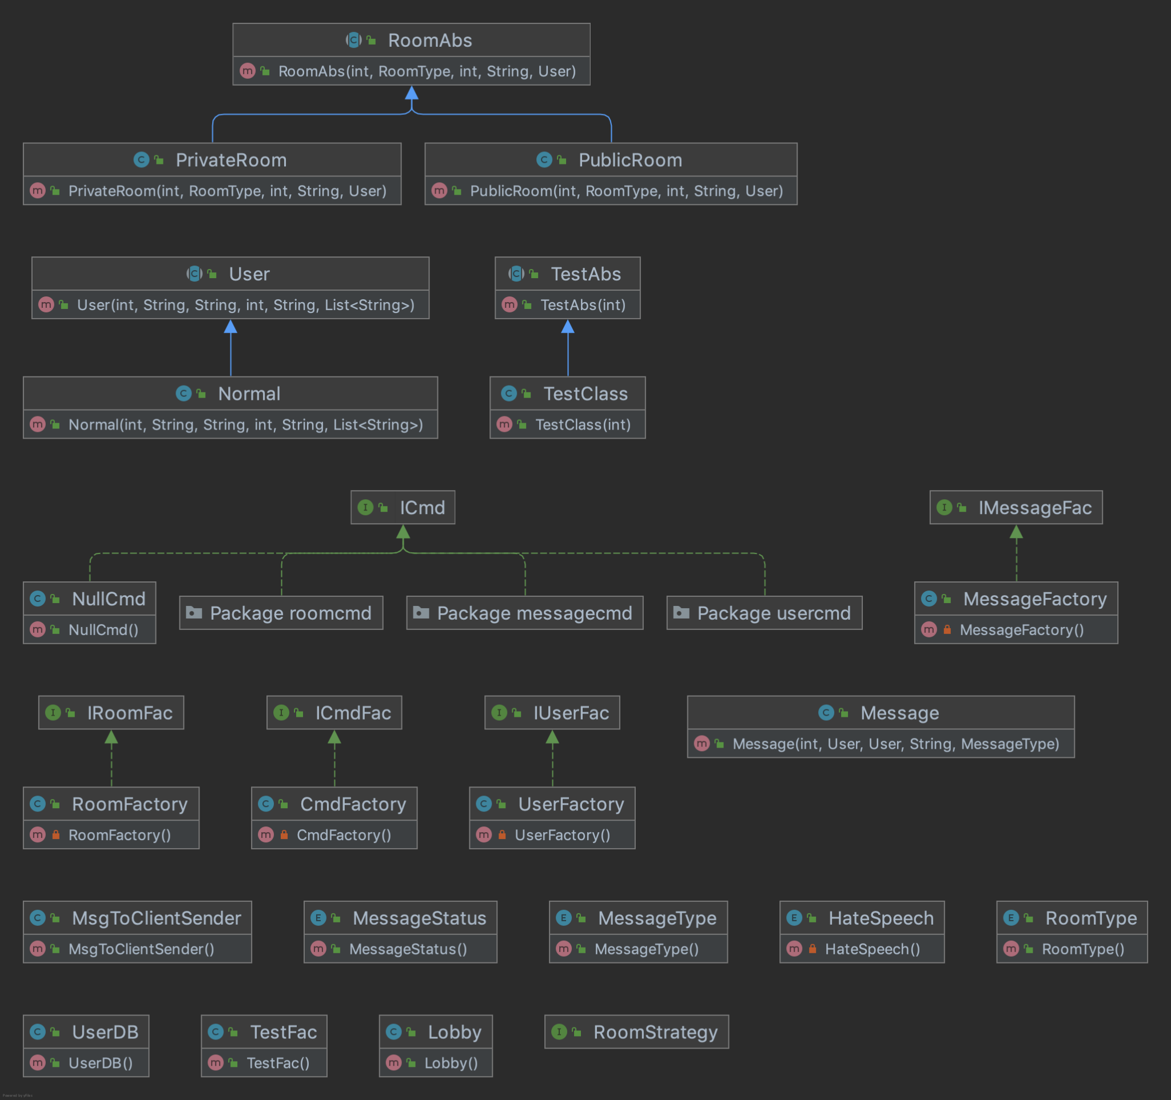
UML Diagram

Slide 9
Design Patterns
MVC Design Pattern
Model: User, Room, Message, Lobby...
View: GUI
Controller: ChatAppController
Union Design Pattern
PrivateRoom, PublicRoom
Command design Pattern
userCmd: RegisterCmd, LoginCmd, getProfileCmd
roomCmd: JoinRoomCmd, QuitRoomCmd, InviteUserCmd, BanUserCmd…
messageCmd: SendMsgCmd, RecallMsgCmd, EditMsgCmd, DeleteMsgCmd
Singleton and Factory Design Pattern
RoomFactory, UserFactory, MessageFactory, CmdFactory...

Slide 10
Design Patterns - Union Design Pattern

Slide 11
Design Patterns - Command Design Pattern

Slide 12
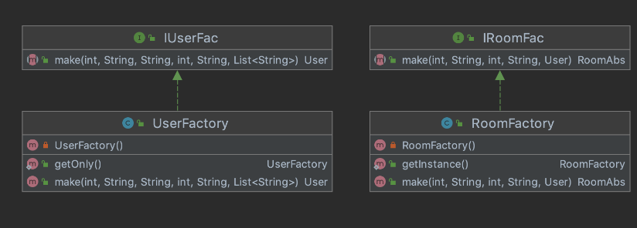
Design Patterns - Singleton and Factory
Factory
Singleton

Slide 13
Outline
Introduce team
Use cases
UML and Design Patterns
GUI Demo
Q/A

Slide 14
GUI DEMO
User Register, Login and Profile
Create and Join Room
Invite and ban user
Send Message in public or private
Edit, Recall and Delete message

Slide 15
Any Questions?

